Slide 1
Look at M.E.
The new museum experience

Slide 2
Look at M.E.
The new museum experience

Slide 3
Look at M.E.
Look at M.E. is a project built for IoT Course 2020 of MSc in Engineering in Computer Science in Sapienza for the "Museo dell'Arte Classica - Sapienza".
The purpose of this project is to improve the experience for the museum visitor by guiding him making sure he fully enjoys all that the museum has to offer. On the activation through several proximity sensors the lighting in the room will create a light-guided path for the visitors to follow while also giving info about the art pieces through speakers.

Slide 4
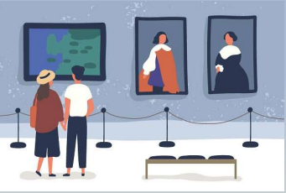
For the visitors
Our product offers two different type of outputs; one aimed to the museum visitors and one for the museum curator.
For the visitors in fact on activation a guided tour made by light that sequentally light up all the statues in the room and audio output to give visitors additional informations on the art pieces.

Slide 5
2nd Delivery

Slide 6
1
Changes
CONTENTS
2
Future Implementations

Slide 7
1
Changes

Slide 8

Changes
Comments
As the commentator suggested, LORA is not responsive enough. So, in order to address this issue we have made some changes that will be explained in the next section of this document. About the last part of the comment, there was a misunderstanding. The illumination is, indeed, controlled by the board, just not directly. It means that we intend to use MQTT lamps that will subscribe to the broker through specific topics and will respond based on the messages published by the board.

Slide 9
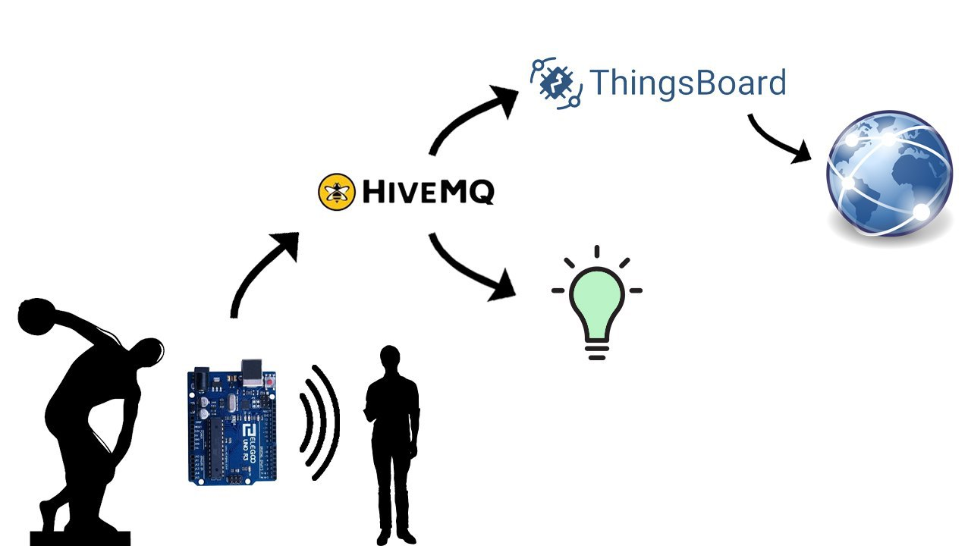
Changes
Changes
The major change is leaving LORA in favor of a pure MQTT architecture for the communications between the end nodes and the cloud infrastructure (ThingsBoard). This had repercussions on the hardware used, in particular, we switched from a B-L072Z-LRWAN1 "st-lora" board to a ELEGOO UNO microcontroller. The ELEGOO UNO microcontroller will use a Bluetooth module to send the data to a PC.
The board is fully operative in controlling the proximity sensors, the button and the led. Through a Bluetooth module it communicates with a PC that has a python script running which has two functions: storing persistently the data and publishing data to the MQTT "HiveMQ" broker. This broker will forward the messages to both the MQTT clients subscribed and the ThingsBoard broker.

Slide 10
2
Future Implementations

Slide 11

Future Implementations
Features and Evaluation
The clients are python scripts which emulate the behavior of both the illumination and the smart speakers, which will be replaced with real ones. The web application is still working in progress.
In the final delivery of the project, we intend to collect users' reviews for the different rooms in the museum, focusing on the impact of Look at M.E. by confronting the result of the rooms with and without Look at M.E.

Slide 12
Demo

Slide 13


Slide 14
Evaluation

Slide 15
1
Overview
2
User
CONTENTS
3
Technical
4
Conclusions

Slide 16
1
Overview

Slide 17
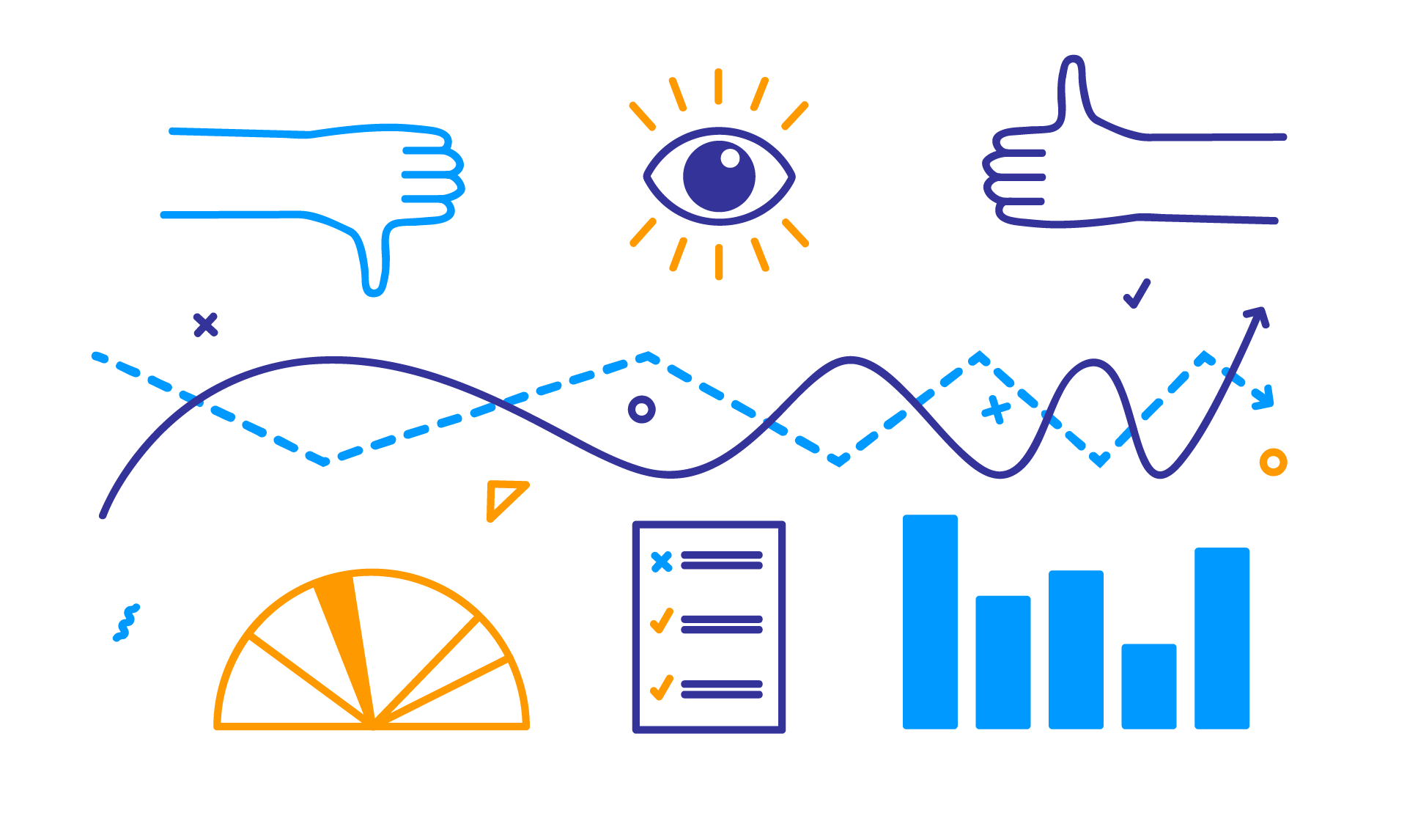
Overview
Overview
Project evaluation is a systematic and objective assessment of an ongoing or completed project. The aim is to determine the relevance and level of achievement of project objectives, development effectiveness, efficiency, impact and sustainability. Evaluation assesses how well planning and managing for future impact is being done during the project cycle. To be useful, an evaluation must respond to the needs and interests of the users and provide information that facilitate decisions their making.

Slide 18

Overview
2nd Delivery
For this second delivery the evaluation will keep in consideration the work and the tests done so far.
Since the evaluation from the user point of view depends on what the user thinks of the final product, in this development phase, we will take as good what has considered for the first presentation.
Instead for the technical point of view we will use the new data taken from the implementation of a first prototype

Slide 19
2
User

Slide 20
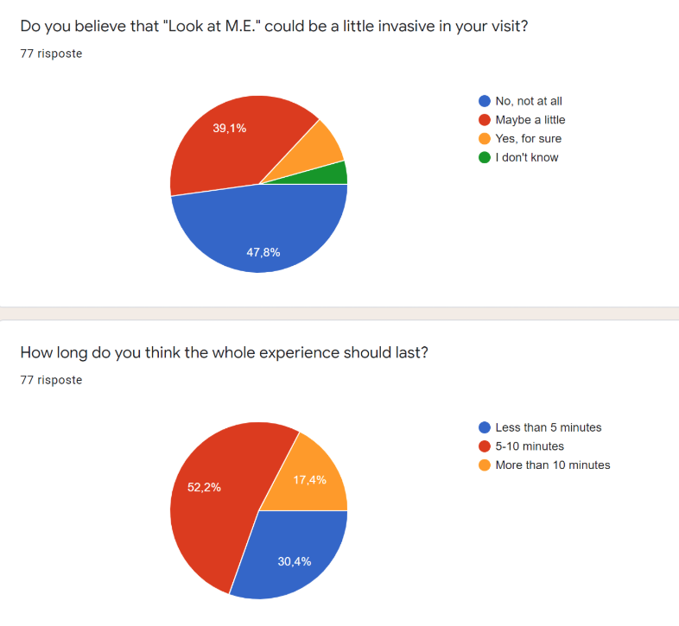
User
User Point of view
To help museum curators and visitors of “Museo dell’Arte Classica - Sapienza” we created “Look at M.E.”. The strategic point of our project is the involvement by the user in a visual and sound experience that can change the point of view on the works of art.
From the user point of view, what stands out from the survey is that the experience sometimes can be a little invasive, in fact we can see from the chart below that the 40,9% of them believe that. Also, we can see that for several users the whole experience shouldn’t last longer than 10 minutes.

Slide 21
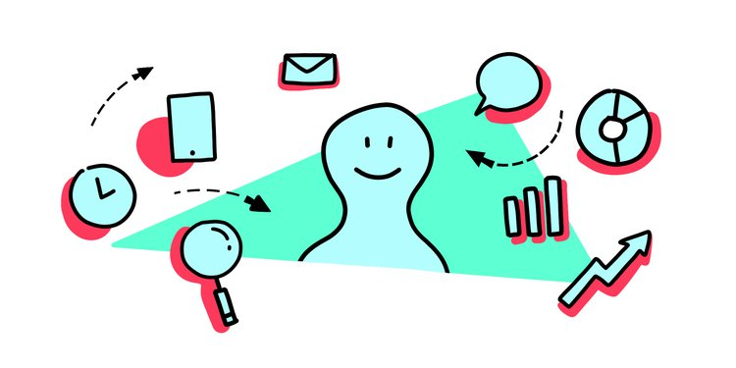
User
What's next
A lot of work still has to be done, in fact, we will review the results obtained in the forms and see if in the next phase of the development the thoughts of the users correspond.
Also, in the final state of the project, we will see the user reviews for the different rooms in the museum, paying attention to the impact of Look at M.E. by confronting the result of the rooms with and without Look at M.E.

Slide 22
3
Technical

Slide 23

Technical
Technical Point of view
From the technical point of view we have started working with real components so some evaluation parameters have shown up such us the proximity sensor precision and responsiveness of the project.
We will address these different problems and the result of our evaluation

Slide 24
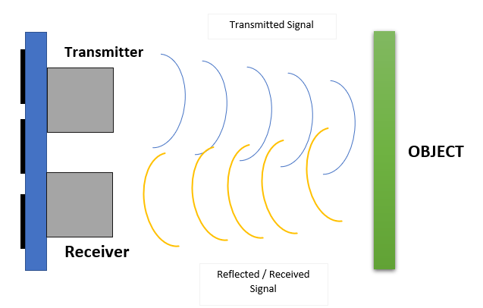
Technical
The HC SR04 sensor
The proximity sensor has proved to be higly precise in the ideal case where there the transmitter is staying still.
A problem where some measurements wrongly gave as result 0 caused by a board movement that made impossible for the receiver to get the reflected signal. As of now we addressed this issue by ignoring return values of zero for the publish to the broker

Slide 25
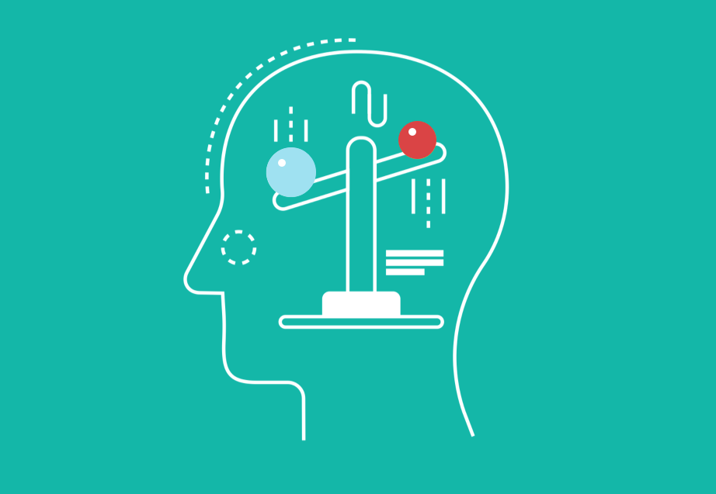
Technical
Other considerations
Also we need to check if the popularity table is biased by the fact that the sensor can only detect the presence/absence of object in front of him and does not consider multiple people.
Finally the responsiveness of the project is one of our main goal, we tested and proved that mqtt is responsive enough to manage different device and values with good results.

Slide 26
4
Conclusions

Slide 27

Conclusions
Final considerations
The final results are good and encouraging also in this phase of development at least for the technical point of view.
A lot of work has still to be done expecially considering the user point of view where we would need the implementation of Look at M.E. in a real environment

Slide 28
Future Plans

Slide 29
1
Technical Development
CONTENTS
2
Evaluation

Slide 30
1
Technical development

Slide 31


Technical Development
Hardware
From an hardware point of view as of now we only created ad hoc some clients that subscribe to a specific topic in our web broker to show what would be the working system, but in the future we will try to use real life devices like smart lightbulbs and sound systems to see the project working in a real environment.

Slide 32
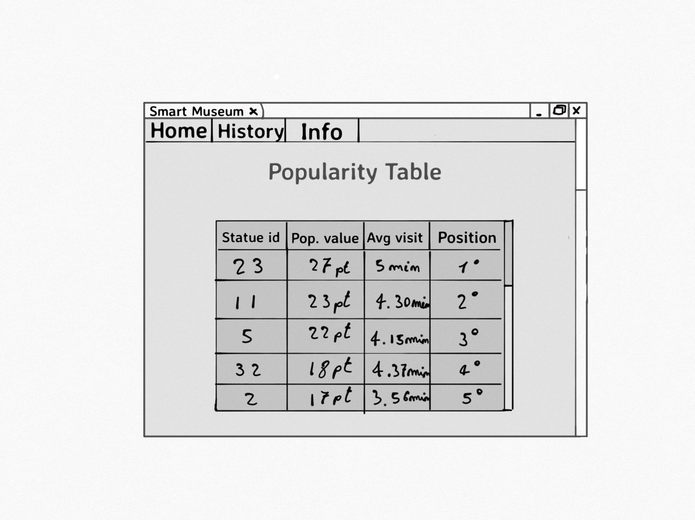
Technical Development
Software
Talking about the software instead, we decided to further develop the ranking system by working on the point attribution according to some specifications.
In this way we will reward more pieces of art that are “activated” by someone watching them for a long time as well as maybe considering the distance of the user from the statue in the rankings.
Also, we still need to complete our web application where all the data will be shown.

Slide 33
2
Evaluation

Slide 34
Evaluation
What's next
In the evaluation a lot of work still has to be done, in fact, we will review the results obtained in the forms and see if in the next phase of the development the thoughts of the users correspond.
Also, in the final state of the project, we will see the user reviews for the different rooms in the museum, paying attention to the impact of Look at M.E. by confronting the result of the rooms with and without Look at M.E.

Slide 35
Thanks！

